Slide 1

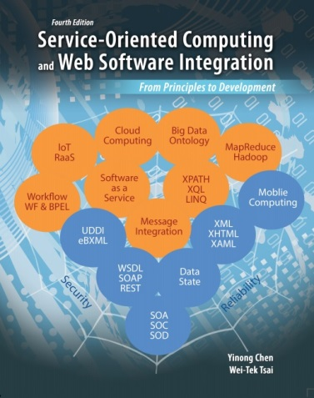

CSE 445 / CSE 598
Distributed Software Development
Chapter 2
Distributed Computing and Multithreading
Lecture 05 Basic Concepts
(Read Text Chapter 2)

Slide 2
Chapter 2 Outline
C# Basics
You must be familiar with Java or C++ or C#. If not, please spend extra time to read textbook sections 2.1 and 2.2, and to make sure you can understand the programs in the slides.
What is distributed and multithreading computing?
Java multithreading
C# multithreading
Thread/Process synchronization and communication
Event-driven programming and a case study

Slide 3
How is this Chapter Related to SOC?
Foundation of distributed computing paradigm; It is a required topic of this course.
Many problems/techniques, e.g., threading and synchronization, studied in this chapter have been embedded into the SOC development environment, and thus the application builders are freed from solving these problems.
For developing basic services, these problems can be made transparent. However, when developing advanced services, you can control instances and currency of service execution (Ch. 7).
Event-driven programming using events and event-handlers is frequently used in SOC and is essential to understand many of the applications to be discussed in the remainder of the course.
If a service provider wants to write his/her own hosting services (self-hosting in Ch. 7), this chapter is important.

Slide 4
Managing Execution of Services (Text Chapter 7, Section 7.2)
InstanceContextMode
For state management
Single
PerSession
PerCall
Instances
Single
Reentrant
Multiple
ConcurrencyMode
For concurrency

Slide 5
C# Basics: Comparing with C++ and Java Reading: Text Chapter 2, Section 2.1
Feature | C++ | C# [Java]
main() | A global function outside any class | public static function in a class
Use of library functions | Header files (#include directives) and the using directive can be used | Header files may not be used. The using [import] directive is used to reference types / classes in other namespaces.
Preprocessor directives | Preprocessor directives and macros are allowed. A macro is an enforced inline function. | Preprocessor directives are allowed, but cannot create macros. Directives can be used for conditional compilation.
Global / static variables or functions | Both are allowed. Both acquire memory from static memory, but have different scope. | Global is not allowed. Static is allowed, which must be contained within a class / type declaration.
Multiple inheritance | Multiple inheritance is allowed. Need to declare virtual classes if the base classes share members. | A class can inherit one base class only. However, a class can implement multiple interfaces without the implementation.
Override | Declaring override functions does not require the override keyword | Declaring override methods requires the override keyword.
Garbage collector and destructor | No automatic garbage collector. The destructors is called automatically, but a programmer can call the destructor. | There is an automatic garbage collector. Programmer cannot call the destructors in C#. C# unmanaged code collects garbage manually
long type | Depends on the computer, can be 32 bits | Independent of the computer, 64 bits

Slide 6
C# Basics: Comparing C++ and C#
Feature | C++ | C#
Array declaration | The brackets "[]" appear following the array variable, e.g., int myArray[] = {1,2,7}; int myArray = new int[8]; | The brackets "[]" appear following the array type, e.g., int[] myArray = new int[100];
String type and operation | An array of characters with a terminator. Use functions: e.g., strcmp | A string type is defined. One can use == and != to compare two string objects.
Pointer | Allowed. | Pointers are allowed only in unsafe mode, e.g.: unsafe { swap(&x, &y); }
switch statement | support fall through from one case label to another. Use break to exit. | Does not support fall through from one case label to another. The break is implied.
foreach statement | Not supported. | Iterate design pattern: Used to iterate through arrays and collections.
Value type and reference type | Primitive types are value types and pointer can be applied to both value and reference types | Value type can be automatically “boxed” into a reference type when a value is passed to a reference. A boxed value can be “unboxed” when it is passed to an value type variable
Example:
int v = 55;
object x = v; //box int value v into reference type
Console.WriteLine ("Value is: {0}", x);
int v2 = (int) x; // unbox / cast an object

Slide 7
Primitive Types and Ranges in C and C++
Type Guaranteed minimum range ≥ bits
bool true/false 1 (8)
char -127 to 127 or 0 to 255 8
signed char -127 to 127 8
unsigned char 0 to 255 8
int -32,768 to 32,767 16
signed int same as int 16
unsigned int 0 to 65,535 16
short int -32,768 to 32,767 16
signed short int same as short int 16
unsigned short int unsigned int 16
long int ±2,147,483,647 32
signed long int same as long int 32
unsigned long int 0 to 4,294,967,295 32
float 6 decimal digits of precision 32
double 10 decimal digits of precision 64
long double 10 decimal digits of precision 64
wchar_t same as unsigned int 16

Slide 8
Primitive Types in C# (Machine-independent)
Data type | Description | bits | Data range | Example
byte | Short integer of 8 bits | 8 | 0 thru 255 (2⁸-1) | byte b = 123;
int / Int32 | Integer of 32 bits | 32 | -2³¹ thru 2³¹-1 | int x; Int32 y = 200;
long / Int64 | Integer of 64 bits | 64 | -2⁶³ thru 2⁶³-1 | long x = 300; Int64 y;
float / single | Real number, floating-point number | 32 | ±3.4 * 10³⁸ 7-decimal precision | float z = 3.4; z = z + 5.1
double | Double precision real number | 64 | ±1.7 * 10³⁰⁸ 16-decimal precision | double d = 3.000000001;
decimal | Smaller data range, but much higher precision | 128 | ±7.9 * 10²⁸ 28-decimal precision | decimal z = 3.0000004m;
char | One unicode character | 16 | 0 thru 2¹⁶-1 | char ch = ‘A’;
String | Sequence of characters | 16 ea | Length determined when it is initialized. | string str = “Hello World”;
bool | Boolean | 8 | True or false | bool flag; flag = true;

Slide 9
Distributed Computing / Multithreading
The ability of executing different parts of a program simultaneously.
In the OS case, the parts of code executed in parallel are called processes or tasks and are often semantically independent of each other (but can be related).
OS performs process scheduling and resource (processors, memory, peripherals, etc.) allocation. OS system-calls allow users to create, manage, and synchronize processes.
In the case of the application program, the parts of code executed in parallel are called threads. More often they are semantically dependent (but can be independent).
In both cases, programmers must carefully design the OS/application in such a way that all the processes/threads can run at the same time without interfering with each other, and produce the same/correct result no matter in what orders they are executed.

Slide 10
Process/Thread vs. Program/Method
A program/method is a piece of code written by a programmer – static.
A process/thread consists of an executing program/method, its current values, state information, and the resources used to support its execution – dynamic.
A process/thread is a dynamic entity which exists only when a program/method is running.

Slide 11
Distributed Computing Environment
To execute multiple processes/threads truly in true parallel, multiple processors must exist.
If only one processor exists, multiple processes/threads appear to execute simultaneously, but actually execute sequentially in time sharing mode.
The code and data contained within different processes/threads are, by default, separated: each has its own copy of executable code, own stack for local variables, and each has its own data area (heap) for objects and other data elements.
Processes/Threads can share variables (e.g., global variables) then, synchronization is necessary.
Why multitasking?
A method does not have

Slide 12
Distributed Computing & Threading
Cache
Process #1
Data area
OS
Shared
memory
multicores
. . .
Private variables
Distributed
OS
Process #k
Cache
multiprocessors
Send / Receive
Private variables
Process #1
Cache
OS
Shared
memory
. . .
Private variables
Process #m
Cache
Threading can be managed at
Hardware-level,
Software-level,
or Runtime
JVM / .Net
Private variables
Thread #1
Cache
Shared
variables
. . .
Private variables
Thread #n
Cache

Slide 13
Critical Operations on Shared Resources
Online Shopping (booking) Example
Flight ticket purchasing example: There is one seat left for a particular flight:
Client A sees the seat is available
Enter the checkout page
Enter the credit card number
Client B sees the seat is available
Enter the checkout page
Enter the credit card number
Client A purchases the seat
Client B purchases the seat
Result in double booking

Slide 14
Automatic Teller Machine (ATM) Example
class Account {
// ...
public boolean withdraw(long amount)
{
if (amount <= balance)
{
long newbalance = balance - amount;
balance = newbalance;
return true;
} else
return false;
}
private long balance;
}

Slide 15
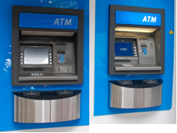
A "Perfect" Synchronization?
Assume the initial balance is $1,000. Two withdraw requests are made almost simultaneously at two ATMs.
Balance withdraw 1 withdraw 2
1,000 if amount<=balance
1,000 if amount<=balance
1,000 newbalance=...;
1,000 newbalance=...;
0 balance=...;
0 balance=...;
0 return true;
0 return true;
Time
newbalance = balance - amount;
balance = newbalance;
balance = balance - amount;

Slide 16
A Simple Solution: Synchronized Access
acquire lock
Will this solution work for bank account class?
Check balance
wait to
Synchronized
code
acquire
New = Bal - withdraw;
lock
Bal = New;
release lock
acquire lock
Check balance;
synchronized
New = Bal - withdraw;
code
Will this solution work for flight booking class?
Bal = New;
release lock

Slide 17
Critical Operations on Shared Memory
Consumer-Producer Problem
Buffer
Producer
Consumer
Shared variables
Shared variables
array[0..N–1] item: buffer;
integer: counter = 0, N = 10;
// Producer thread
repeat produce an item; while counter == N do skip; deposit item in buffer;
counter := counter + 1; until false;
// Consumer thread
repeat while counter == 0 do skip; extract item from buffer; counter := counter – 1; consume item; until false;
What would happen if one thread is interrupted (blocked, quantum/timeslice expired) in the middle of the loop and the other thread is executed?

Slide 18
A Potential Problem in Applying Locks: Deadlock
A deadlock is a situation wherein two or more competing actions are waiting for the other to finish, and thus neither ever does.
A typical situation is, two or more threads need more than one resource to proceed, and each holds (locks) one resource while waiting for other threads to release the resources.
Acquire resource1 (available items)
and lock resource 1
Acquire resource2 (shopping cart)
and lock resource 2
Wait for
resource 2
Wait for
resource 1
Thread
1
Thread
2

Slide 19
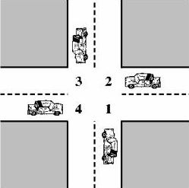
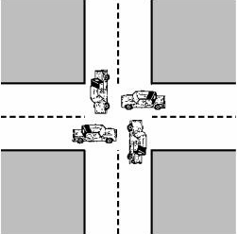
Traffic Deadlock (multi-party deadlock)
Deadlock possible:
Each vehicle needs two sections of the road
to proceed.
Deadlock occurs:
Each vehicle hold one section of the road,
waiting for the second section to clear.

Slide 20

Resolving Deadlock (1)
Deadlock prevention: use an algorithm which can guarantee that no deadlock can occur, e.g., prevent the condition to occur.

Slide 21

Resolving Deadlock (2)
Deadlock avoidance: use an algorithm which will anticipate that a deadlock is likely to occur and therefore refuse a resource request.
Using traffic lights and closable gates at level-crosing.

Slide 22


Resolving Deadlock (3)
Deadlock detection and recovery: use an algorithm to detect the occurrence of a deadlock and force the threads to release the resources that are held while waiting.

Slide 23


Deadlock Example: Dining Philosophers Problem
Five philosophers are thinking and eating
They share a round table with 5 bowls and five chopsticks.
Thinking: independent;
Eating: one shares chopsticks with one's two neighbors.
A philosopher may only pick up one chopstick at a time
P1
Chopstick
[1]
Chopstick
[2]
P0
P2
Chopstick
[0]
Chopstick
[3]
P4
P3
Chopstick
[4]

Slide 24
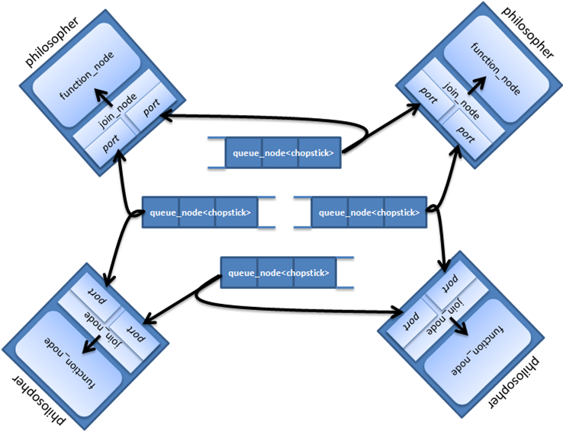

Parallel Implementation Using Intel® Threading Building Blocks (Intel® TBB)
http://software.intel.com/en-us/blogs/2011/01/10/using-the-intel-threading-building-blocks-graph-community-preview-feature-an-implementation-of-dining-philosophers/?cid=sw:Dining_Philos_Blog_JK4
Four philosophers are shown in the diagram. In the code, the number is a variable.

Slide 25
Livelock
A condition that occurs when two or more threads continually change their states in response to the changes of other threads.
Different from deadlock, where the resources are held, the resources in the livelock are still free
The result is that none of the threads will obtain the resource to complete.
Example, two threads try to acquire a lock at the same time, sleep for the same amount of time if the lock is on, then wake up and try to acquire the lock again at the same time.
Analogy: two persons meet in a hallway. Each tries to step aside to let the other person through but they end up swaying from side to side getting in each other's way as they try to get out of the way.

Slide 26
Livelock Avoidance in Ethernet
CSMA/CD protocol with binary exponential backoff
Before sending, a node listens to the bus and sends if the bus is free
If a collision occurs, waits for a random time
by 1st collision, wait 0 or 1 slots of time;
by 2nd collision, wait 0, 1, 2, or 3 slots;
by 3rd collision, wait 0, 1, 2, 3, 4, 5, 6, or 7 slots;
by 4th collision, wait 0 , 1, 2, 3, ..., or 15 slots;
…
by nth collision, wait 0 , 1, 2, 3, ..., or 2^{n-1} slots.

Slide 27
Starvation and Avoidance
A thread is theoretically able to gain access to the shared resource (lock), but practically unable to gain regular access and is unable to make progress.
Particularly, when the threads are given priorities. If there are too many threads with high priorities, the threads with a low priority may starve.
One of the solution is to dynamically change the priorities of threads. The longer a thread waits, the higher the priority of the thread will become.

Slide 28
Unix Support to Distributed Computing
Text Section 2.3.5
Most operating systems support multi-process programming. For example:
In Unix, several system calls are provided for users (programmers) to start parallel processes.
int fork( )
When fork() is executed in a process, it creates a new (child) process, which is basically a copy of its parent process: The same program code (including the fork( ) ), status, user-data, and system-data segments, will be copied. The only difference is that, the two processes will receive different return values from the function fork( ).
The child receives a 0 return value, whereas the parent receives the process-ID of the child. If the parent receives “-1” value, an error has occurred.
fork ( ) has no arguments, the caller could not have done anything wrong. The only cause of an error is resource exhaustion. The parent may want to wait a while (with a sleep call) and try again.
….
switch(fork())
-1: //error
0: // child exec
default: // parent thread
….
switch(fork())
-1: //error
0: // child exec
default: // parent thread
Create a
child process

Slide 29
Unix Support to Distributed Computing
Text Section 2.3.5
int exec( )
Usually, the child process executes an exec system-call after the return of fork, whereas the parent either waits for the child to terminate or goes off to do something else.
The exec system-call reinitializes a process from the given program.
int execl(path, arg0, arg1, ..., argn, null ) // return –1 cannot execute the file
char *path; // path (location) of program file char *arg0; // first argument (program file) char *arg1; //second argument . . . char *argn; // last argument char *null; // null indicates end of arguments
int execvp(file, argv ) // return –1 cannot execute the file char * file; //program file name char * argv[ ]; // pointer to argument list

Slide 30
How is a New Process Created in Unix?
Use int fork( ) system call to create a duplicate of the parent process;
Use int execl() system call to change the parent-copy process to child process
prog.exe
Process P0
Process P1
❍
Program
executable
code
Instructions(prog)
■
Instructions(prog)
user_data(prog)
Create
a copy of P0
user_data(prog)
sys_data(prog)
sys_data(prog)
❍


fork( )
●
execl (prog, data)
wait
for exit
of P1
❍

Slide 31
Case Study: Writing a UNIX Shell: SimShell
SimShell is a simple command Line Interpreter;
When SimShell is running, you can enter a command (program name) followed by a list of parameters;
e.g., equationSolver.exe inMatrix outVector
SimShell will start the program equationSolver, read inMatrix and feed them to the program, and return outVector;
The program can run in foreground (return to SimShell after the command is completed) or in background (return to SimShell immediate);
Simshell is written in C.

Slide 32
Example: Creating a Child Process in Unix
Text Section 2.3.5
#include <fcntl.h> // SimShell is Command Line Interpreter
static void main (int argc, char *argv[ ]) {
while (TRUE) { // read, execute a command and wait for termination
read_command(argv); // equationSolver inMatrix outVector
// argv[0] = “equationSolver.exe”, argv[1] = “inMatrix”, argv[2] = “outVector”
switch(fork()) {
case -1: printf("Cannot create new process \n");
return;
case 0: execvp (argv[0], argv); // execvp does not return to caller
printf("Cannot execute \n"); // execvp returns only by error
exit (1);
default: if (wait(NULL) == -1)
printf("Cannot execute wait system call \n");
// Parent process receives the PID of child process
// and then waits for the termination of child
} } }

Slide 33
Next
Creating a new process is the easy first step;
Managing the correct execution with coordination and synchronization are much harder
We will use Java multithreading and C# multithreading to show the problems and solutions
Synchronization
Coordination
Event-driving communication

